Slide 1
Introduction to Reverse Engineering
CS-577-A, Fall 2021
Jun Xu
Credits of many slides belong to Project Lead The Way
-- https://slideplayer.com/slide/3314038

Slide 2
WHAT is Reverse Engineering?
Reverse Engineering is the process of taking something apart and analyzing how it works, usually with the intention of understanding its structure, function, and operation.

Slide 3
WHY Reverse Engineering
Documentation
Discovery
Investigation
Product Improvement

Slide 4
WHY Reverse Engineering
Documentation
No existing documentation
Interoperability
Maintenance

Slide 5
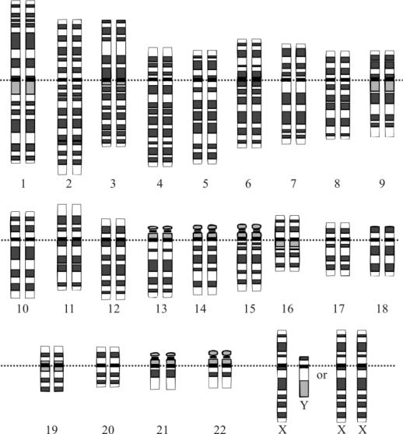

WHY Reverse Engineering
Discovery
Academic/research/learning/curiosity/benefits
Human Genome Project
Reverse-engineer the brain
©iStockphoto.com
Source: Wikimedia, http://en.wikipedia.org/wiki/File:Karyotype.png
Modified from Human Genomne Project

Slide 6
WHY Reverse Engineering
Investigation
Analysis and testing
Document patent infringement
Forensics: Design failure

Slide 7
WHY Reverse Engineering
Improve or redesign a product
Increase efficiency
Improve reliability
Improve manufacturing techniques
Eliminate failure mode
Reduce cost
Increase ease-of-use
Reduce negative environmental impacts
Recycle parts
Etc.

Slide 8
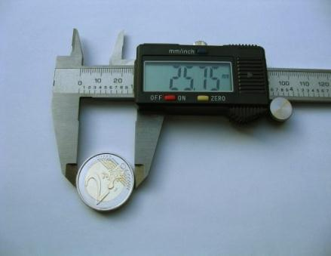
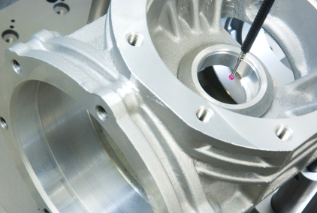
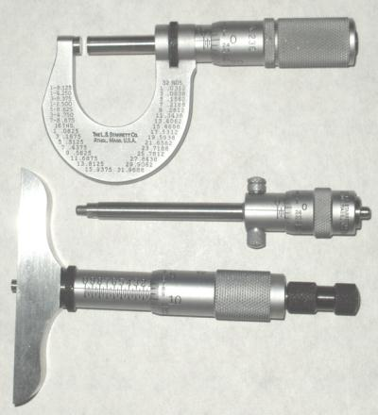

The Key to Reverse Engineering: TOOLS
Caliper
Optical Probe
Source: Wikimedia, author: Christophe Cattelain.
©iStockphoto.com
Micrometers
Medical Imaging
Source: U. S. Air Force photo/Senior Airman Julianne Showalter
Source: Wikimedia, author: Splarka

Slide 9
Reverse Engineering in this Course
Reverse Engineer Software
What does it do?

